Slide 1
Week 3
Consensus Protocol
By
Dr. Faheem Khan

Slide 2
Consensus Protocol
A consensus protocol may be defined as the mechanism through which a Blockchain network reaches consensus. Blockchains are built as distributed systems and, since they do not rely on a central authority, the distributed nodes need to agree on the validity of transactions.
This is where consensus protocols come into play. They assure that the protocol rules are being followed and guarantee that all transactions occur in a trustless way.

Slide 3
Types of Consensus Algorithms
Below is a list of consensus algorithms, there are many other algorithms or protocols beside the ones listed here depending on the specific application and use case of Blockchain. Proof of X, where “X” can be any requirements, is the most exciting field of research for students and researches where creativity plays a major part in creating new consensus algorithms.

Slide 4
Types of Consensus Algorithms
Proof of Work (POW)
Proof of Stake (POS)
Delegated Proof of Stake (DPoS)
Proof of Authority (PoA)
Proof of Assignment (PoA)
Byzantine Fault Tolerance (BFT)
Leased Proof of Stake (LPoS)
Proof of Elapsed Time (PoET)
Proof of Activity (PoA)
Proof of Importance (PoI)
Proof of Capacity (PoC)
Proof of Burn (PoB)

Slide 5
1. Proof of Work
Most cryptocurrencies including Bitcoin run on “proof of work”. Proof of work as a process has the following steps to it:
• The miners solve cryptographic puzzles to “mine” a block to add to the Blockchain.
• This process requires an immense amount of energy and computational usage.
• The puzzles have been designed in a way that makes it hard and taxing on the system.
• When a miner solves the puzzle, they present their block to the network for verification

Slide 6
Continue
Mining serves as two purposes:
To verify the legitimacy of a transaction, or avoiding the so called double-spending;
To create new digital currencies by rewarding miners for per forming the previous task.
Transactions are collected
Miners compete to solve a puzzle
First miner to solve it → adds block
Other nodes verify
Miner gets reward (crypto coins)
This process is called mining

Slide 7
Daily Life Example (Simple)
🧠 Puzzle Competition
Imagine:
100 students solving a very hard math problem
Only the first one who solves it gets a prize
👉 Others verify the answer 👉 Winner gets reward
This is exactly how PoW works in blockchain

Slide 8
Continue
The miner must find a result starting with a number of zeroes. The greater the number of zeroes, the more difficult it is for the miner to find the result and the more it will have to try his luck before finding it.
Yet the number of zeroes (and therefore the difficulty) is adjusted to the number of miners on the network (and their computer capacity or hashing power) to be sure that it will take an average of 10 minutes to find the solution. Once it has found this figure, the other members of the network can instantly check the solution.

Slide 9
Continue
Since the miner may not find the Input data (“input”) from the result (“output”), he/she is going to try his/her luck until he located the Input data enabling him/her to obtain the output data corresponding to the objective of difficulty required, which is the number starting with a number of zeroes sufficient to be validated by the Protocol Bitcoin and thus be added to the Blockchain.
Figure 2.1 is an example of the mathematical puzzle, the goal is to have 3 leading zeroes:

Slide 10
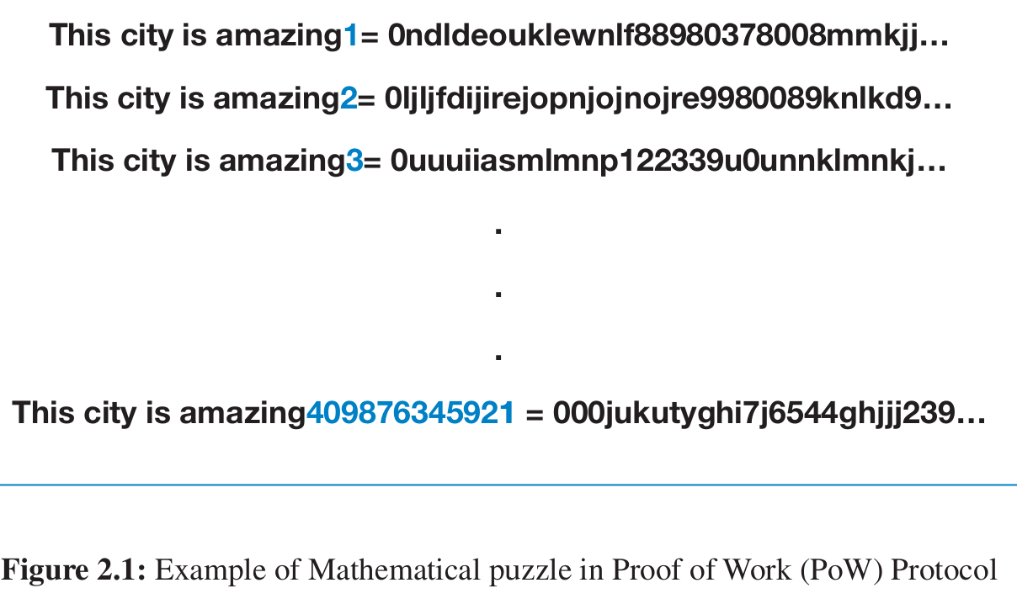
Continue
It took billions of attempts (409876345921)
👉 Because:
Hash output is random
No shortcut exists
Only way = trial and error (brute force)

Slide 11
This city is amazing1 → random hash This city is amazing2 → random hash ... This city is amazing409876345921 → valid hash ✅
This is exactly how mining works in Bitcoin
The phrase "This city is amazing" = input data
The number (1, 2, 3, …) = nonce (a changing value)
Output = hash (random-looking string)
Miners keep changing the number until they get a valid hash

Slide 12
A valid hash must satisfy a condition like:
0000abc9238f...
Means:
It must start with a certain number of zeros
This condition is set by the network (difficulty level)

Slide 13
Daily Life Example (Clear Understanding)
Password Guessing Game
Imagine:
You must guess a password starting with “0000”
You try:
12345 ❌
99999 ❌
00001 ❌
0000X ✅
You keep trying until condition matches, Same as PoW mining

Slide 14
Continue
How Bitcoin Mining Works: A Complete Beginner's Guide
What is Bitcoin Mining for Beginners - Short and Simple

Slide 15
Proof of Stake (PoS)
Proof of Stake is a way a blockchain network agrees on who can add the next block without mining machines.
Instead of using electricity + powerful computers (like Proof of Work), PoS uses coins as a stake (deposit).
How it works
You lock (stake) your coins in the network.
The network randomly chooses a validator (person who staked coins).
The chosen validator checks transactions and adds a block.
Validator earns reward (more coins).
If validator cheats → they lose their staked coins (penalty).
So: More coins staked = higher chance to validate = more rewards.

Slide 16
Daily Life Example
Imagine a lottery with deposit:
10 people join a security club.
Each person deposits money as trust/security.
The person who deposited more money has higher chance to be chosen as the guard for the day.
If the guard works honestly → gets reward.
If the guard cheats → loses deposit.
This is exactly how Proof of Stake works (but with crypto coins).

Slide 17
Crypto Example
Some blockchains use PoS:
Ethereum
Cardano
Polkadot
Example with Ethereum
You stake 32 ETH in Ethereum.
You become a validator.
Network selects you sometimes to confirm transactions.
You earn ETH rewards (around 3–5% yearly, changes).
If you cheat → Ethereum cuts your stake (slashing).

Slide 18
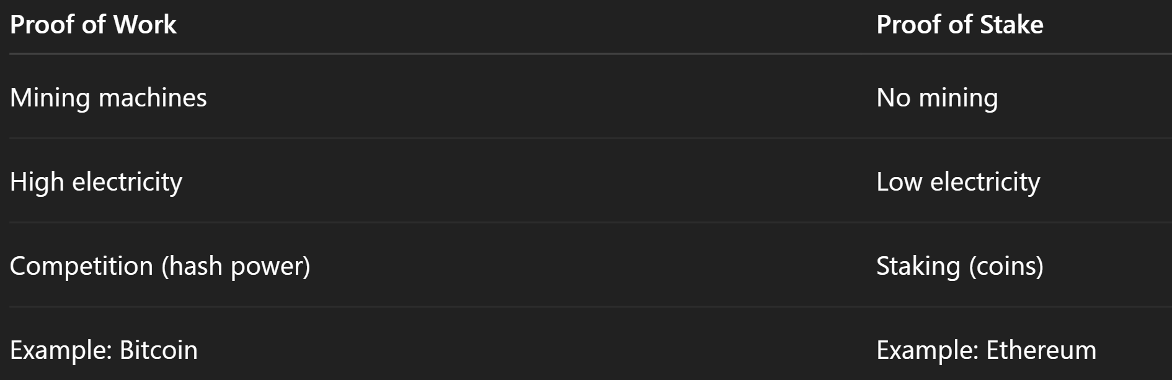
Comparison
PoW = Work (machines work hard)
PoS = Stake (money locked as trust)

Slide 19
Delegated Proof of Stake (DPoS)
DPoS is voting system staking.
Coin holders vote for validators (called delegates / witnesses).
Top voted delegates run the blockchain and confirm transactions.
Delegates earn rewards.
Delegates share rewards with voters.
If a delegate works badly → people remove vote and replace them.
So: Vote → Delegates validate → Rewards shared → Bad validator removed

Slide 20
Daily Life Example
Imagine a school election:
100 students (coin holders).
Students vote for class monitor (delegate).
Top 5 monitors manage class (validate transactions).
Monitors get monthly reward (salary).
If a monitor is lazy or unfair → students vote them out and choose new one.
This is exactly how DPoS works in blockchain.

Slide 21
Crypto Example
Some blockchains use DPoS:
EOS Network
TRON
BitShares
Hold coins → Vote delegate → Delegate validates → You earn reward → Bad delegate removed by voting

Slide 22
Proof of Authority (PoA)
Proof of Authority (PoA) is a blockchain system where trusted and approved validators create blocks.
Instead of staking coins or mining, PoA uses identity + trust.
Only pre-approved authorities can validate transactions.

Slide 23
How PoA Works (Very Simple)
A few trusted validators (known people/organizations) are selected.
These validators confirm transactions and create blocks.
They earn rewards or reputation.
If a validator cheats → they are removed and lose reputation.
So: Trusted identity → Validate → Honest = Stay → Cheat = Removed

Slide 24
Daily Life Example
Imagine a company office entry system:
Only authorized staff with ID cards can open and manage the office.
They are trusted employees (validators).
If an employee misuses power → ID cancelled and job lost.
Not everyone can enter — only trusted authorities. This is exactly how Proof of Authority works.

Slide 25
Crypto / Blockchain Example
Some blockchains using PoA:
BNB Chain (uses Authority-based validators)
VeChain
Ethereum (PoA used in some private/test networks)
Example (VeChain)
VeChain selects approved Authority Masternodes.
Only these trusted validators create blocks.
Network becomes very fast and low cost.
If validator acts badly → removed from authority list.

Slide 26
Advantages
Very fast transactions
Very low fees
Energy efficient
Stable and predictable

Slide 27
Disadvantages
More centralized (few validators control network)
Requires trust in authorities
Less censorship-resistant than PoW/PoS

Slide 28
Proof of Assignment (PoA)
Proof of Assignment means a task is given to the right participant, and they prove they completed it correctly. Instead of everyone doing the same work, the system assigns specific work to specific nodes/people, and they must show proof they did it honestly.
Goal: Save time, reduce duplicate work, increase efficiency.

Slide 29
Daily Life Example
School Homework Example
Teacher assigns math questions to different students.
You only solve your assigned questions (not whole book).
You submit your notebook as proof of assignment.
Teacher checks → correct → you get marks.
Work is divided, verified, and trusted.

Slide 30
Crypto / Blockchain Example
Transaction Validation Example
Network assigns a group of transactions to a specific validator/node.
That node verifies transactions (no double spend, valid signatures, etc.).
Node submits proof it completed the assigned validation.
Network checks → if correct → node gets reward (fees/coins).
Not every node checks everything → faster and more scalable.

Slide 31
Why PoA is useful?
Less energy & computation than everyone doing same work
Faster processing
Better scalability
Clear responsibility (who did what)

